Slide 1
WP2
Optimization with Gurobi

Slide 2
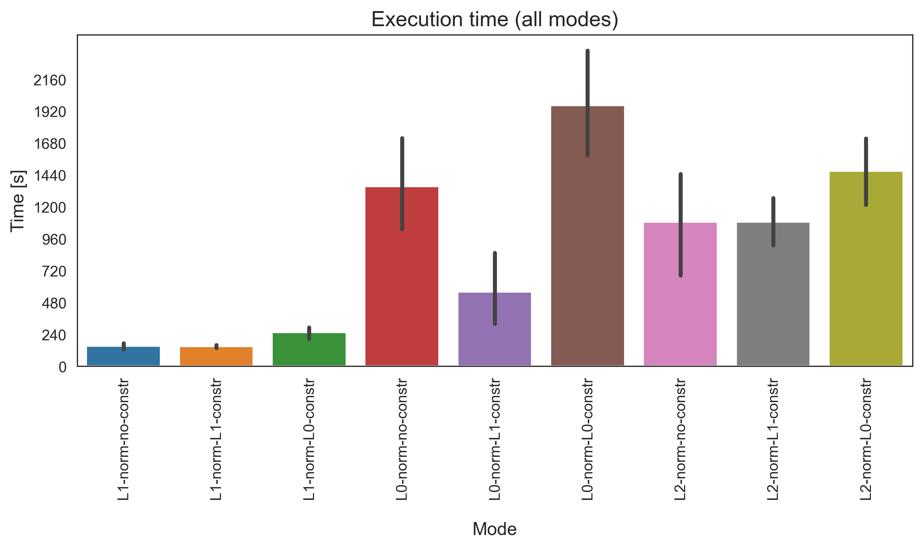
Execution time for one graph file
Full Path Enumeration
Datasets
Human geuvadis simulated
Human leukemia real
Human diverse
SRR307903 (Fibroblasts)
SRR307911 (Embryonic stem cells)
L1 norm
L0 norm
L2 norm

Slide 3
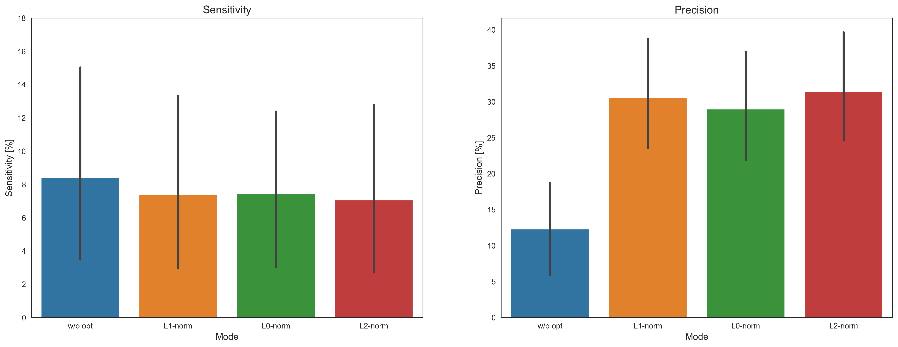
Sensitivity and Precision
Without sparsity constraints

Slide 4
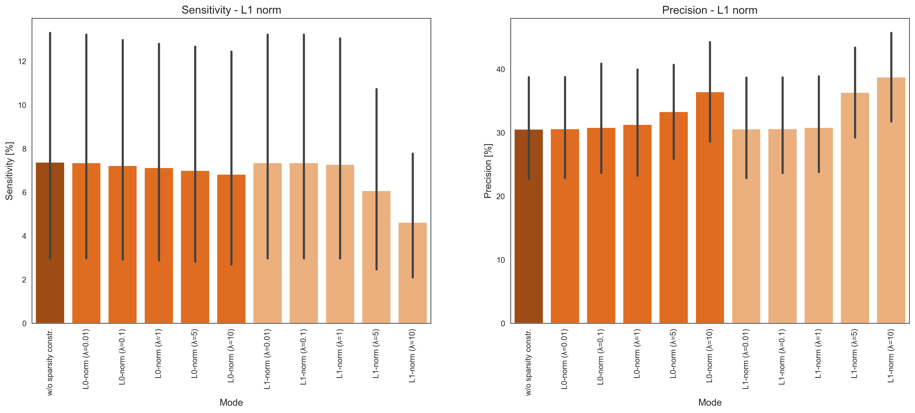
Sensitivity and Precision
With sparsity constraints

Slide 5
WP3
Flow-based Optimization

Slide 6
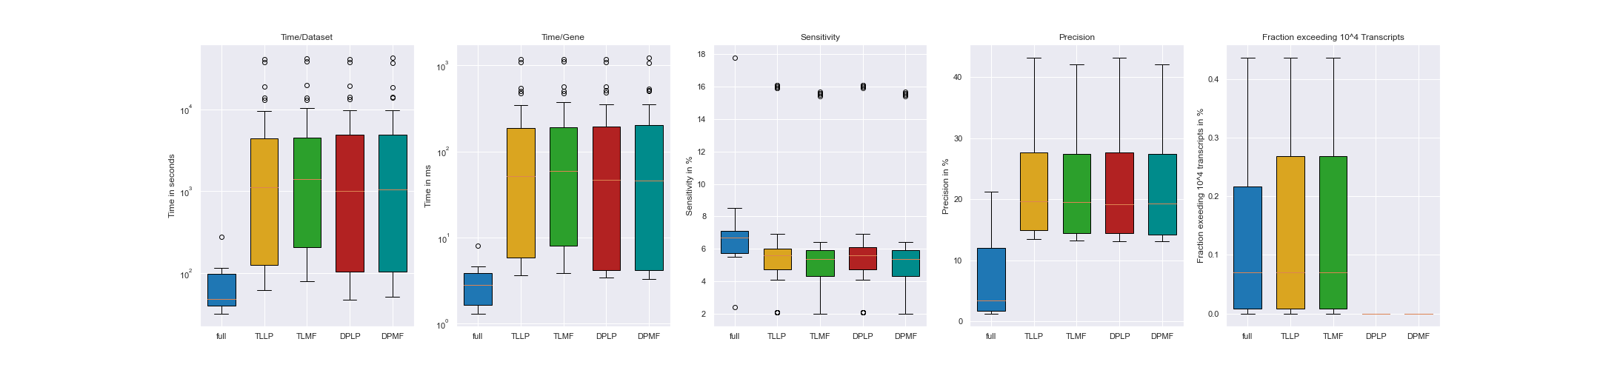
Time Analysis for flow-based Optimization
11 datasets:
Human_simulated
Human_leukemia
Human Diverse
SRR307903
SRR307911
SRR315323
SRR315334
SRR387661
SRR534291
SRR534307
SRR534319
SRR545695
6 cost-functions per mode
3 linear
3 quadratic

Slide 7
Precision and Sensitivity for flow-based Optimization

Slide 8
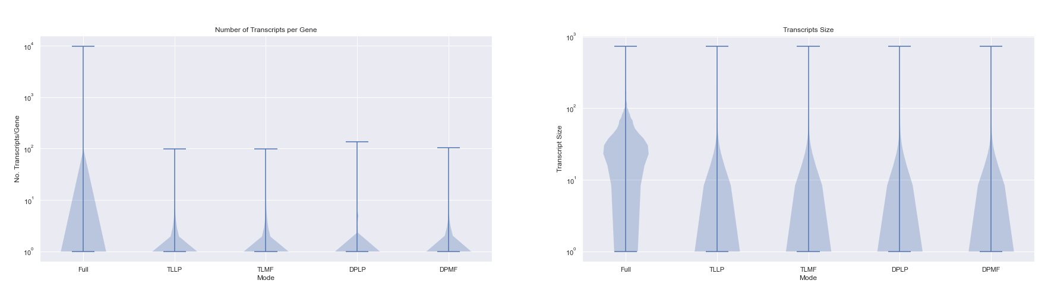
Number of Transcripts and Transcript Size for flow-based Optimization

Slide 9
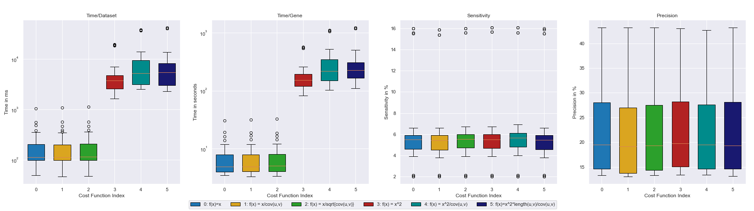
Cost-function dependent results for flow-based Optimization

Slide 10
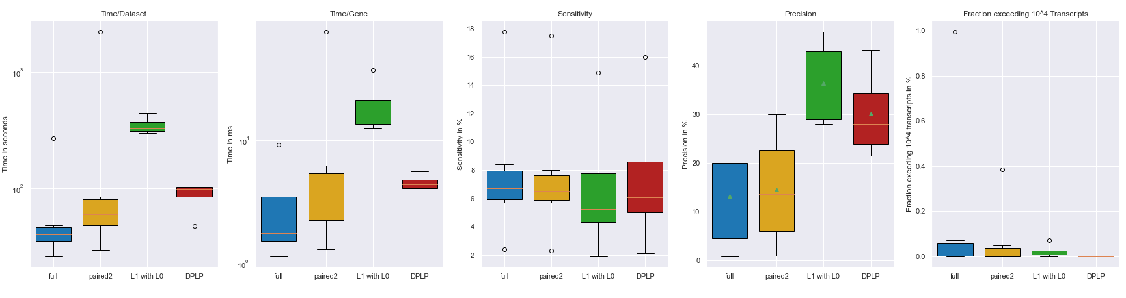
Overall results

Slide 11
Vielen Dank.

Slide 12
Anhang

Slide 13
WP2 - Anhang

Slide 14
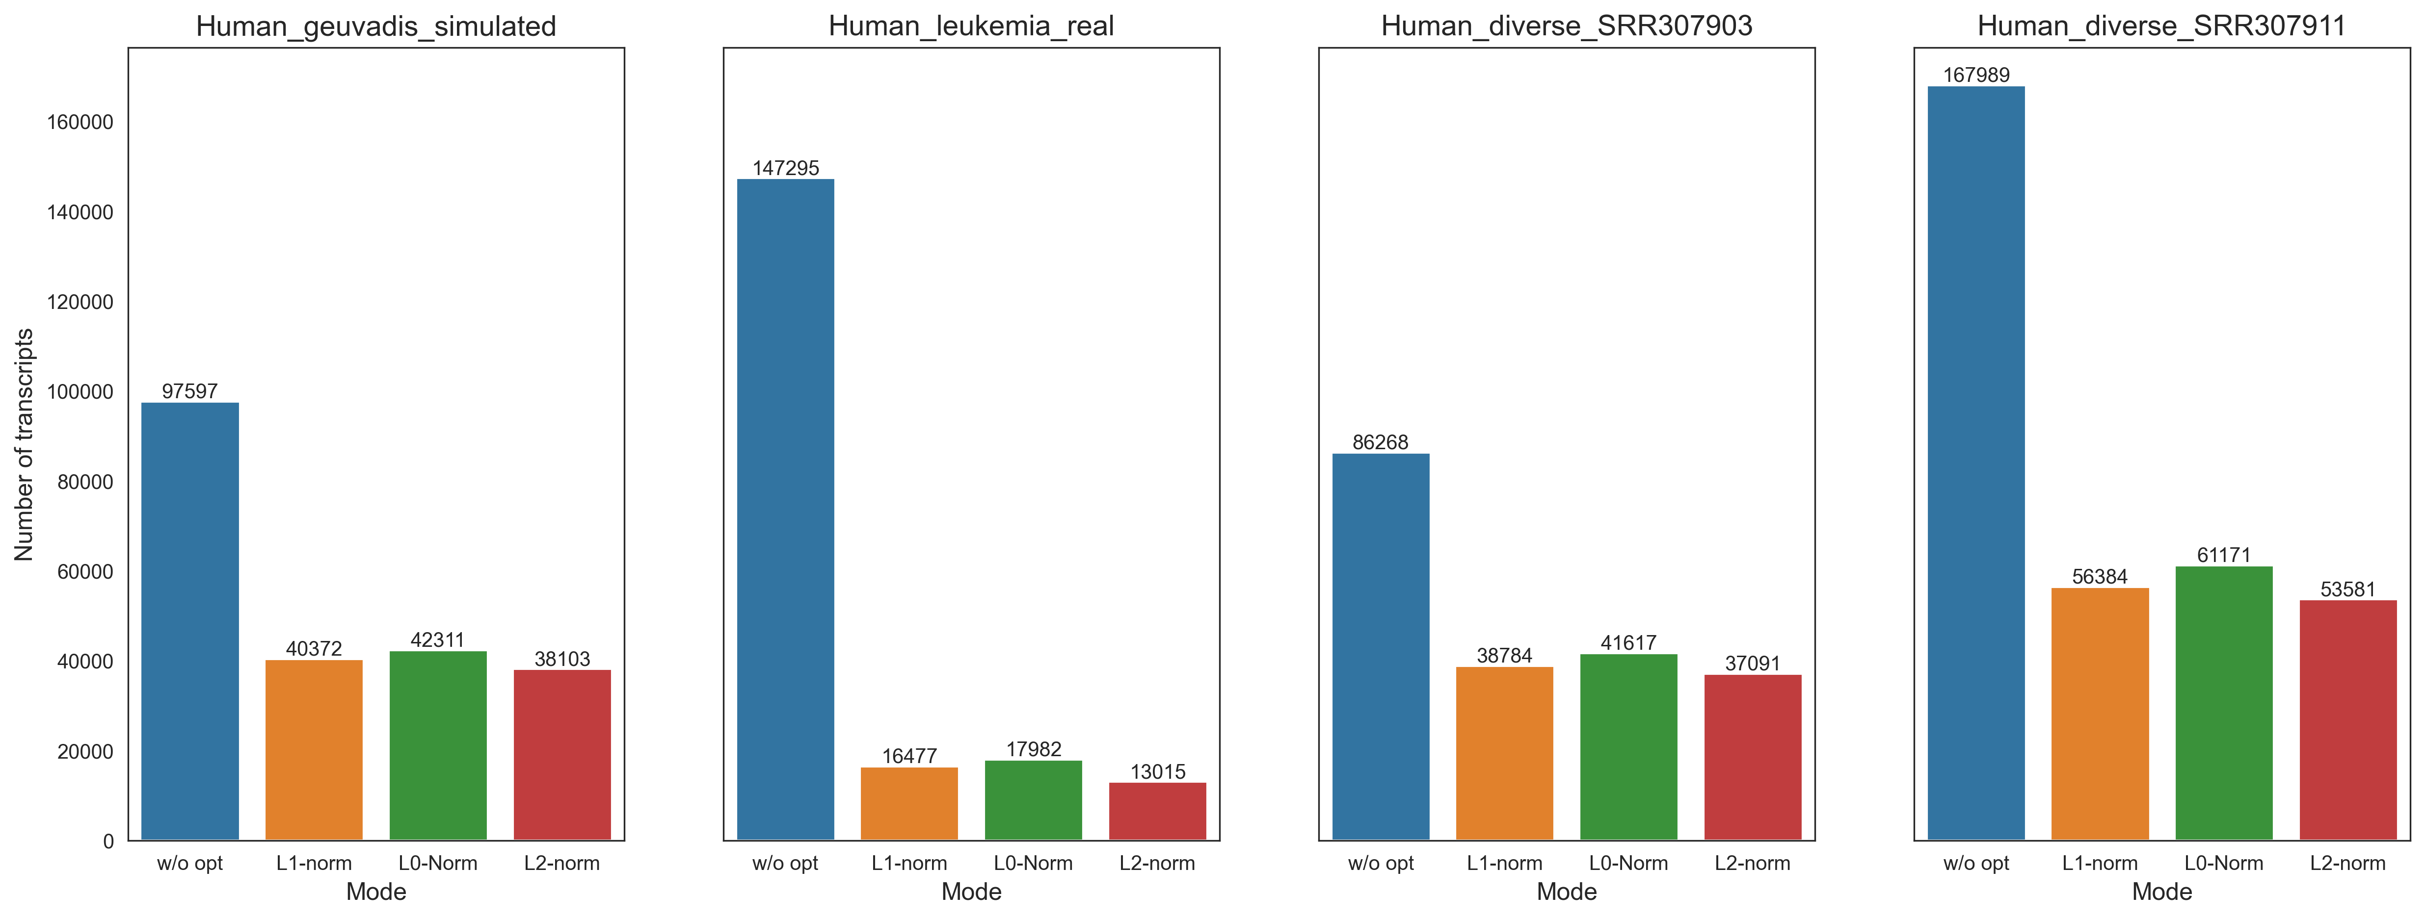
Total number of transcripts
Without sparsity constraints

Slide 15
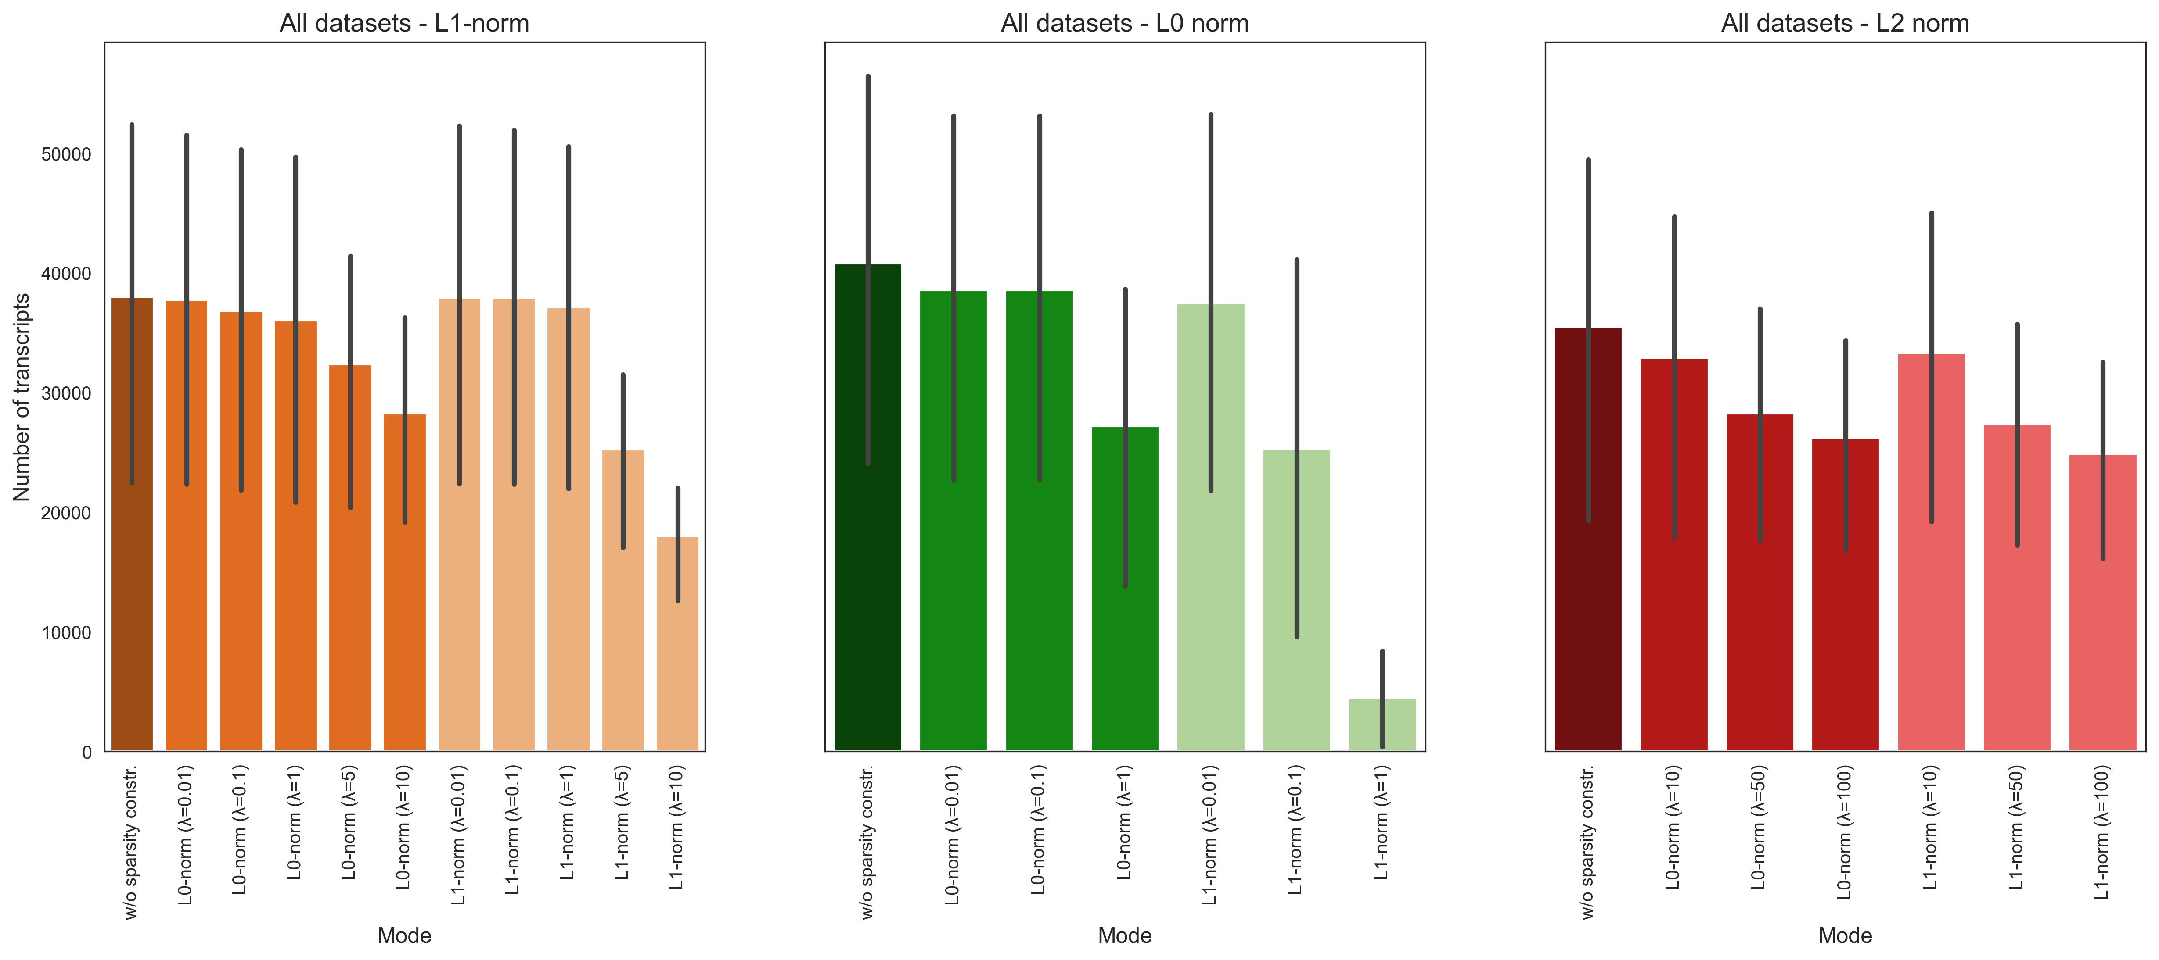
Total number of transcripts
With sparsity constraints

Slide 16
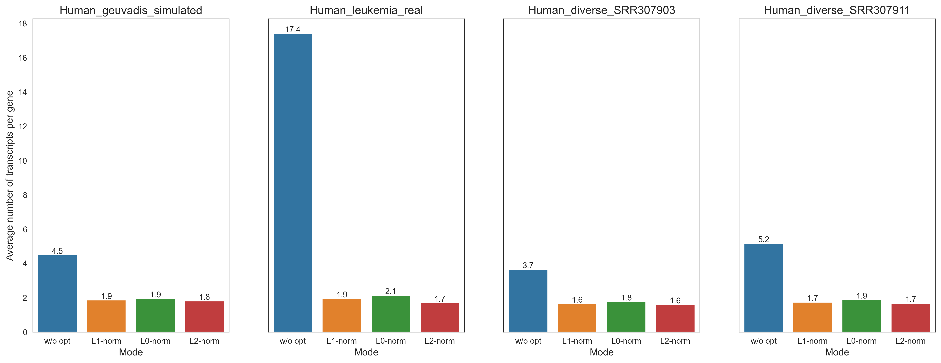
Number of transcripts per gene
Without sparsity constraints

Slide 17
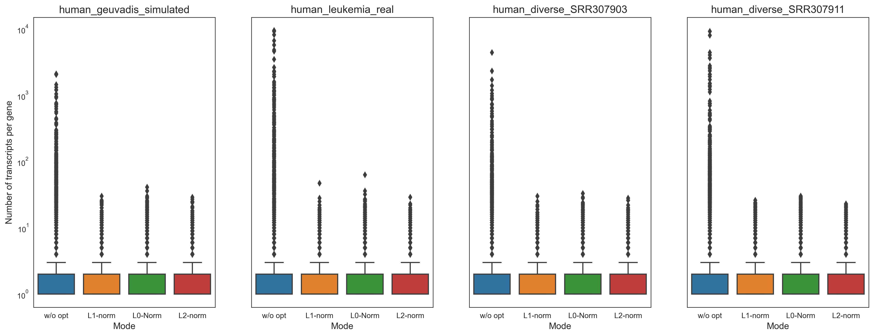
Number of transcripts per gene
Without sparsity constraints

Slide 18
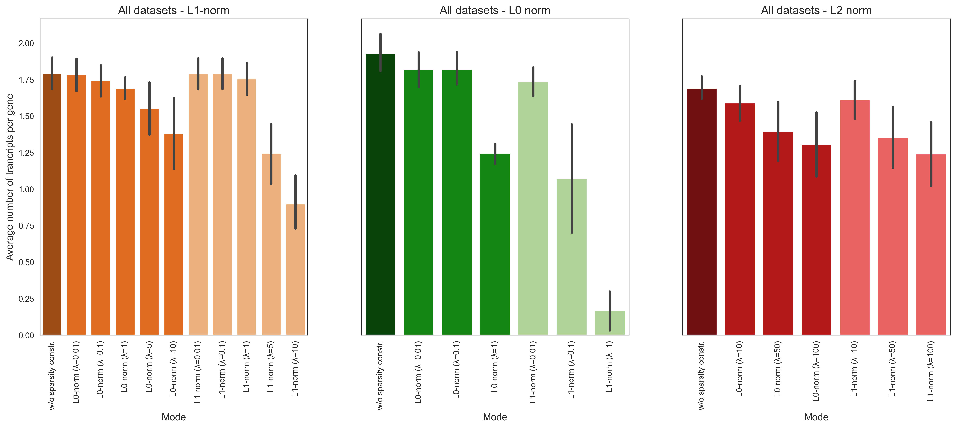
Number of transcripts per gene
With sparsity constraints

Slide 19
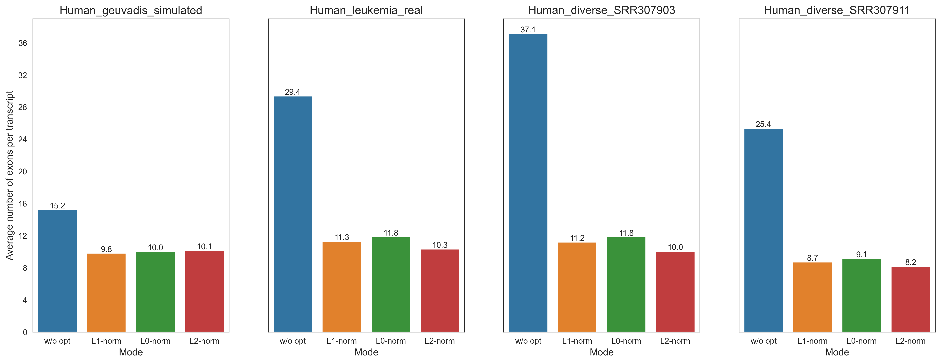
Number of exons per transcript
Without sparsity constraints

Slide 20
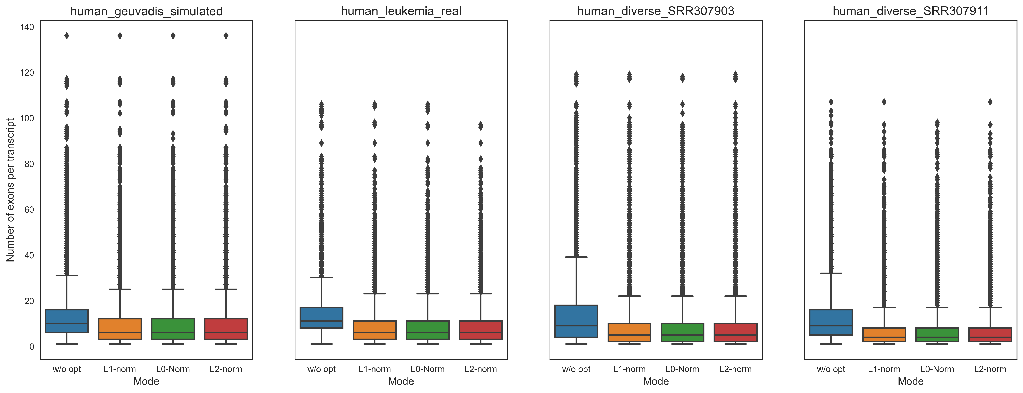
Number of exons per transcript
Without sparsity constraints

Slide 21
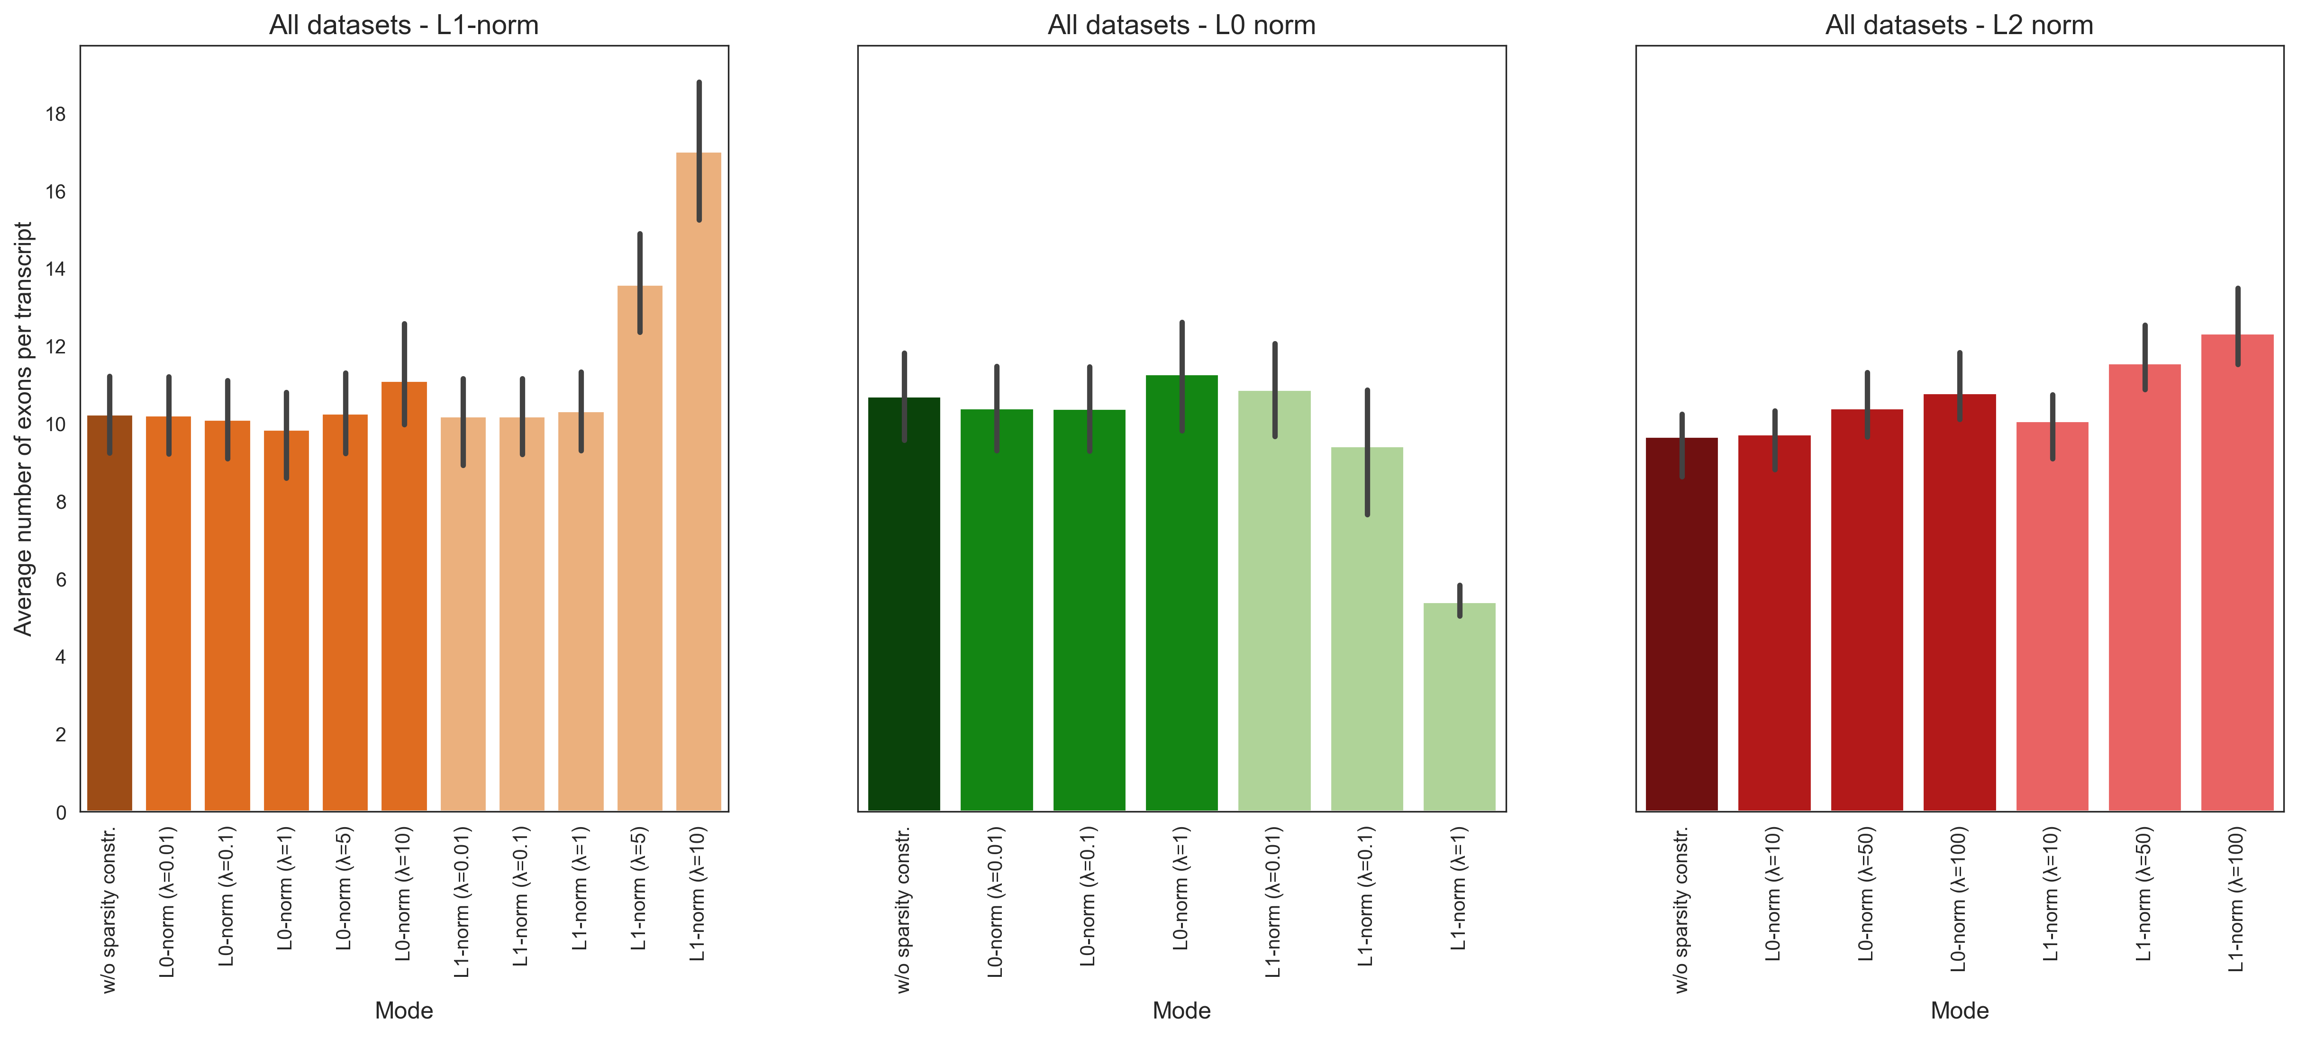
Number of exons per transcript
With sparsity constraints

Slide 22
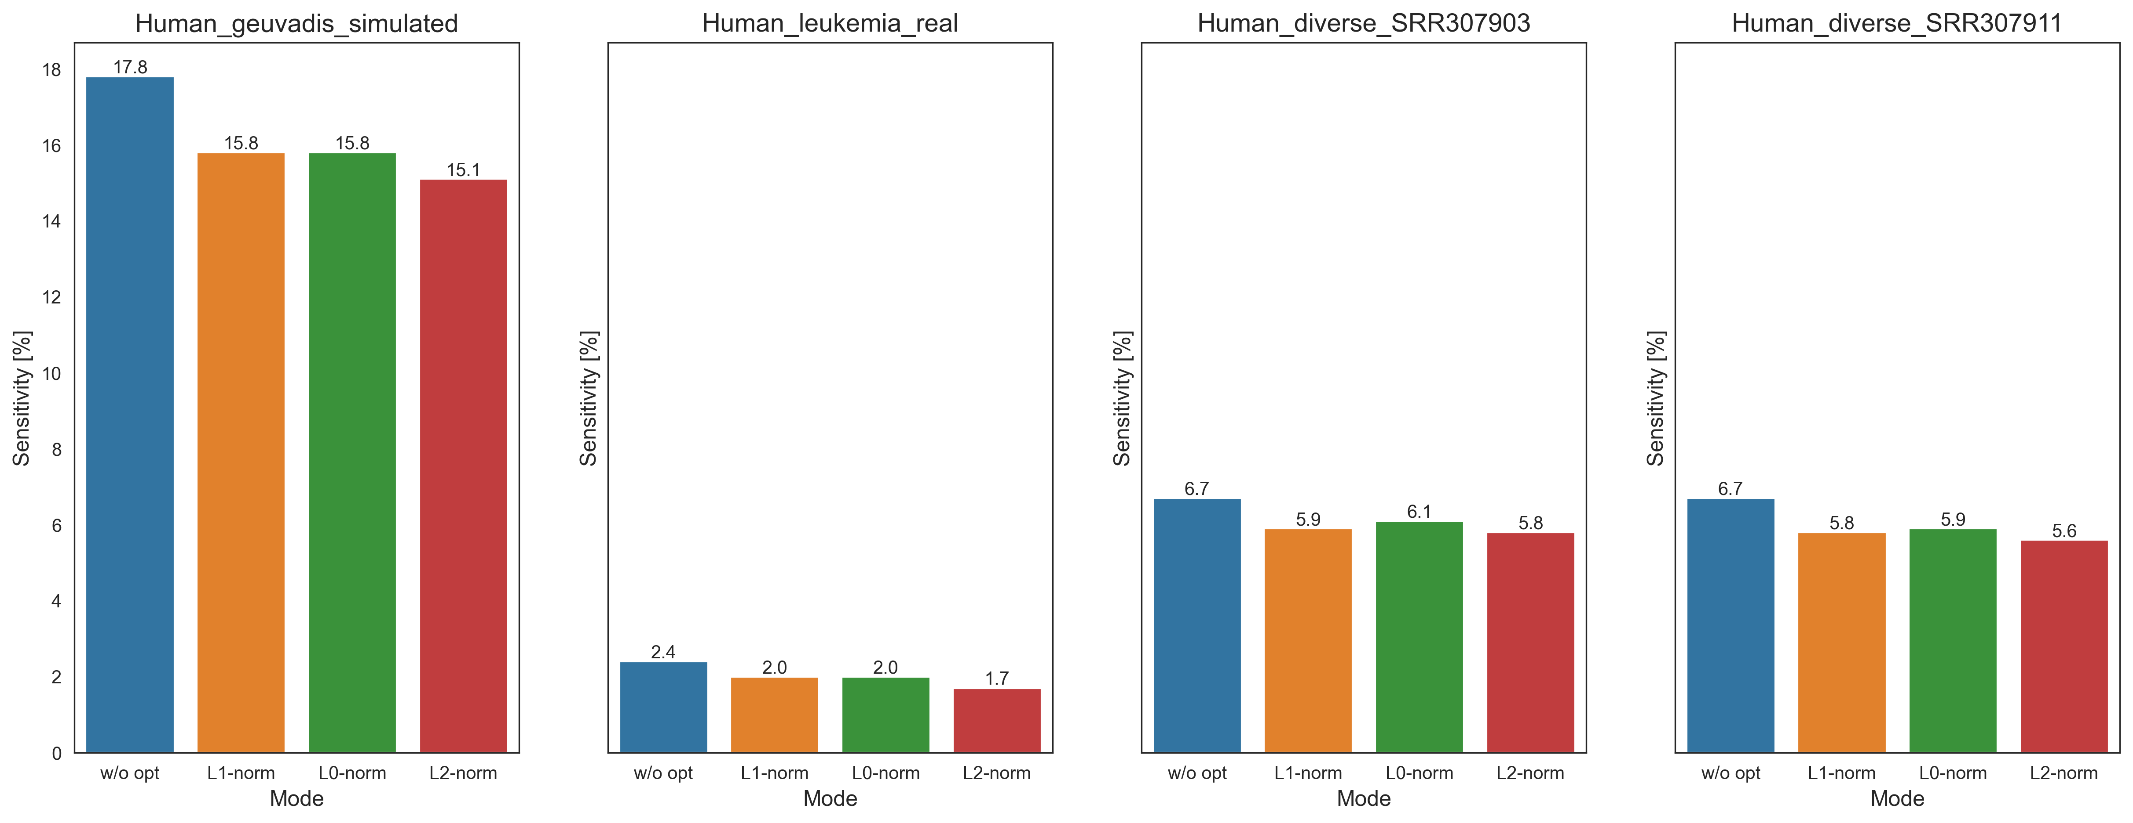

Sensitivity
Without sparsity constraints
$$Sensitivity=\frac{TP}{TP+FN}$$

Slide 23
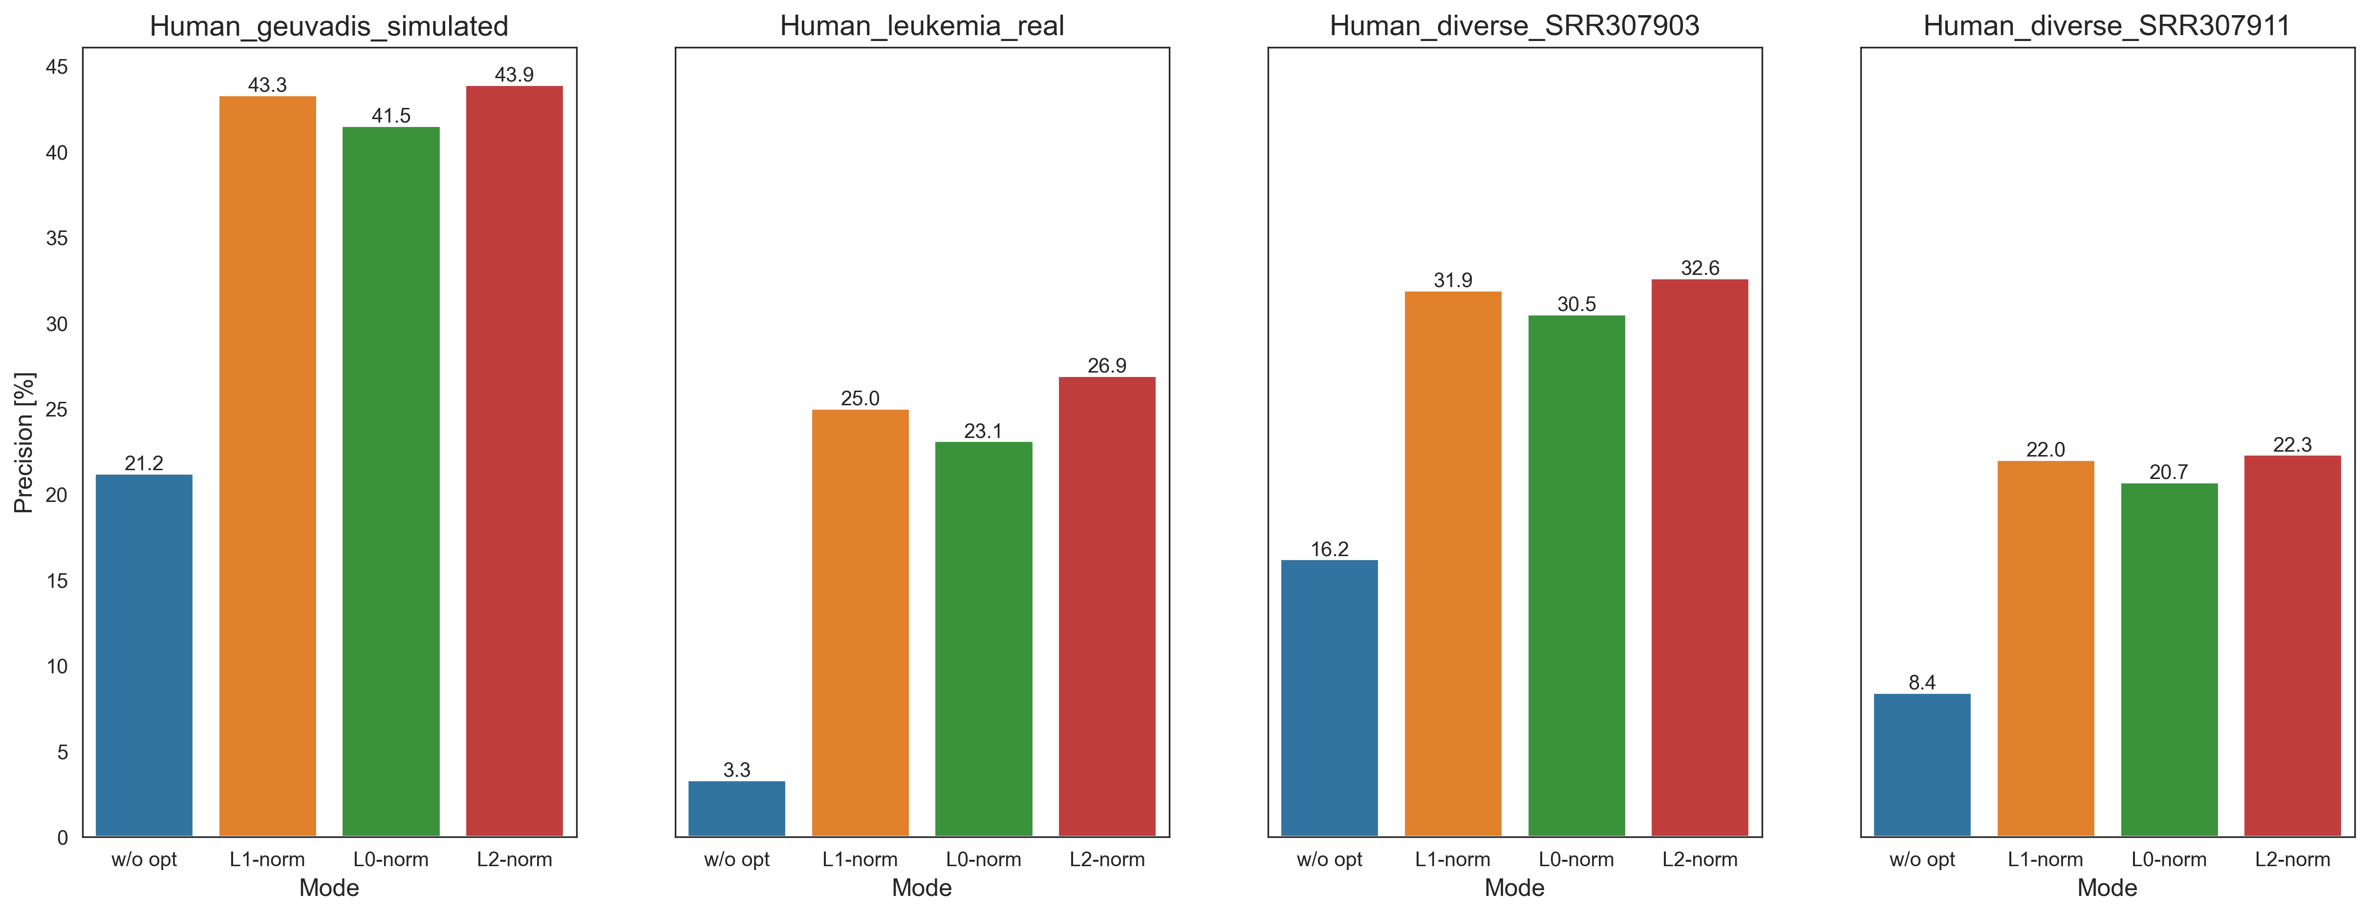
Precision
Without sparsity constraints
$$Precision=\frac{TP}{P}$$

Slide 24
Sensitivity and Precision
L1 norm
With sparsity constraints

Slide 25
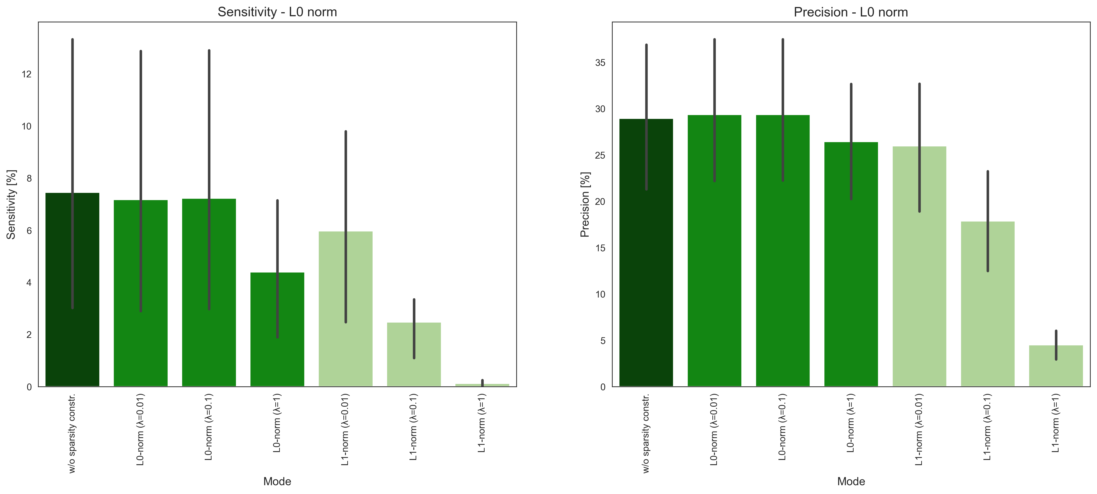
Sensitivity and Precision
L0 norm
With sparsity constraints

Slide 26
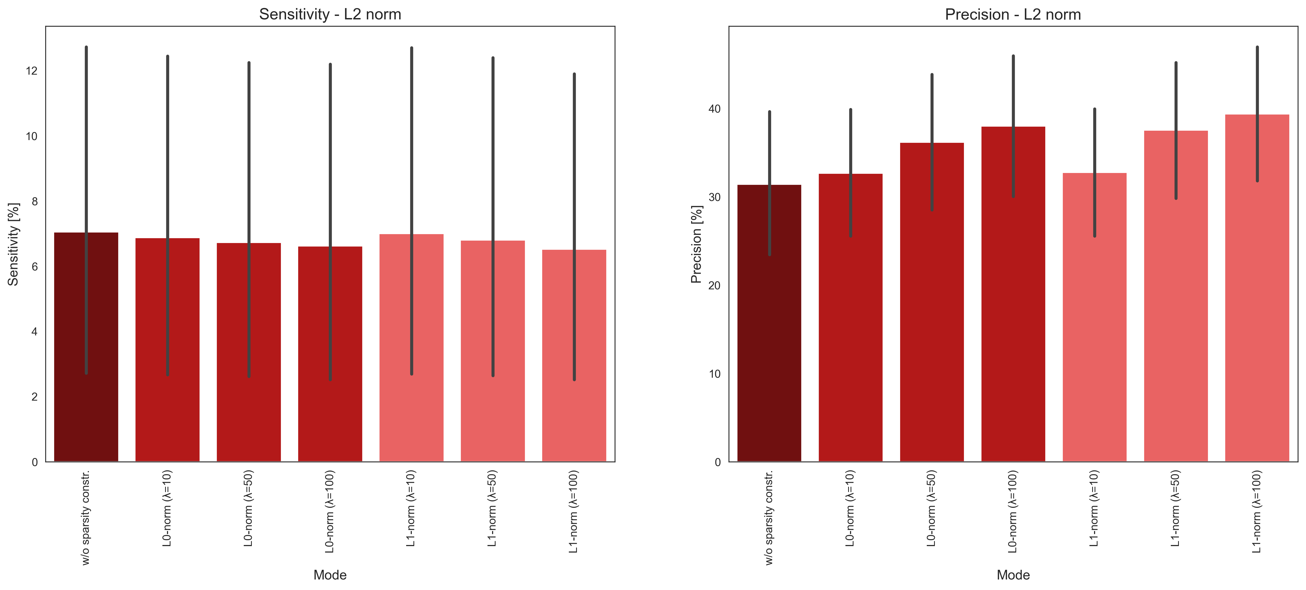
Sensitivity and Precision
L2 norm
With sparsity constraints

Slide 27
Anhang WP3

Slide 28
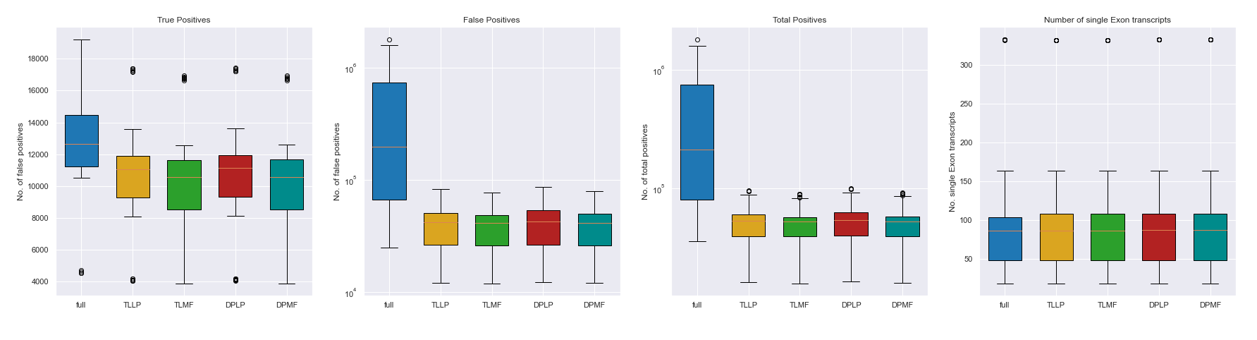
Further Analysis for flow-based Optimization

Slide 29
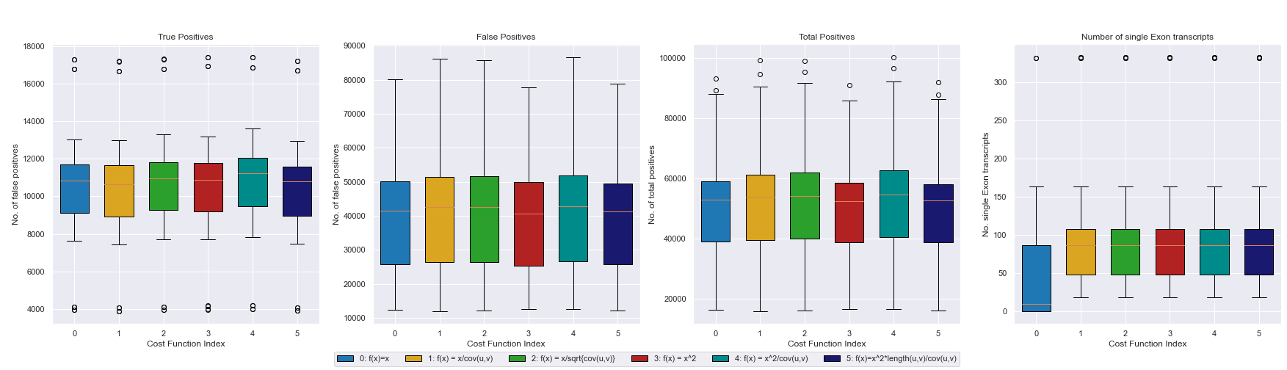
Further Analysis for flow-based Optimization

Slide 30
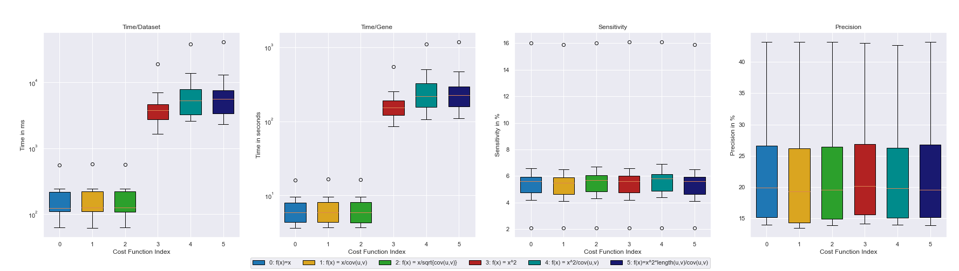
Analysis for flow-based Optimization (TLLP)

Slide 31
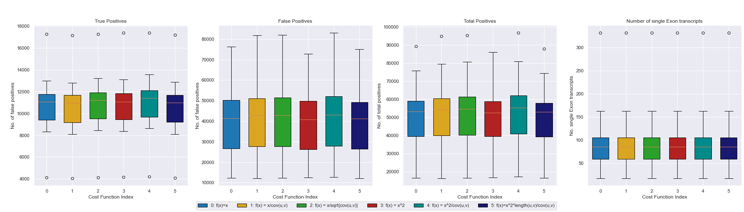
Analysis for flow-based Optimization (TLLP)

Slide 32
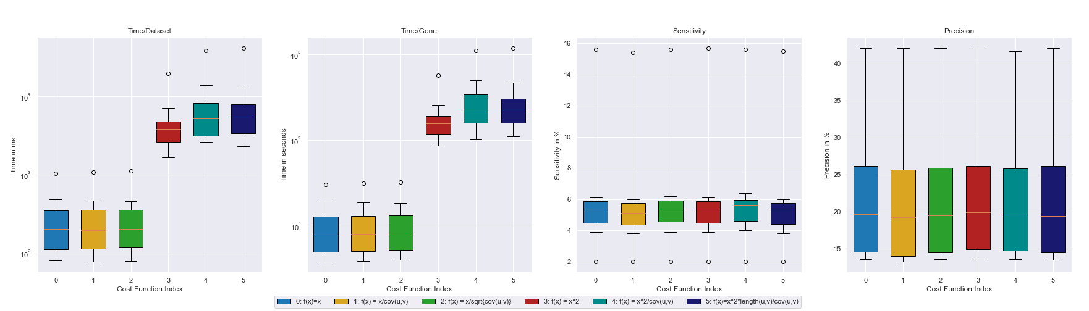
Analysis for flow-based Optimization (TLMF)

Slide 33
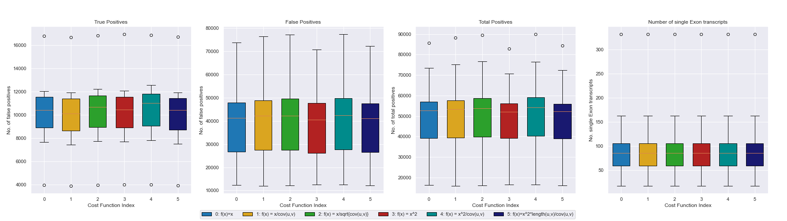
Analysis for flow-based Optimization (TLMF)

Slide 34
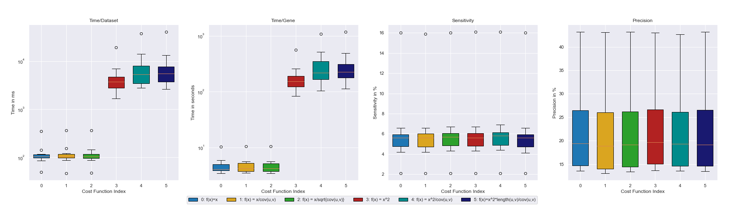
Analysis for flow-based Optimization (DPLP)

Slide 35
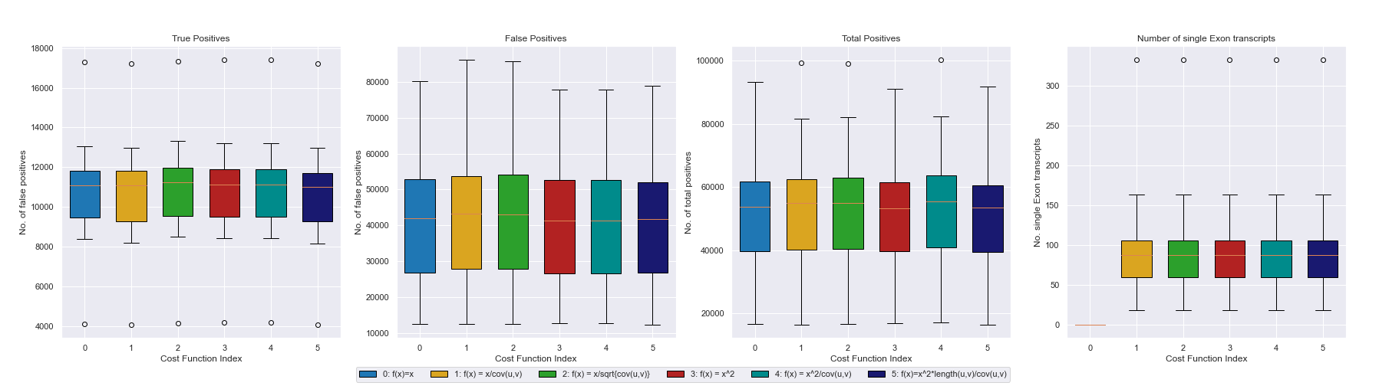
Analysis for flow-based Optimization (DPLP)

Slide 36
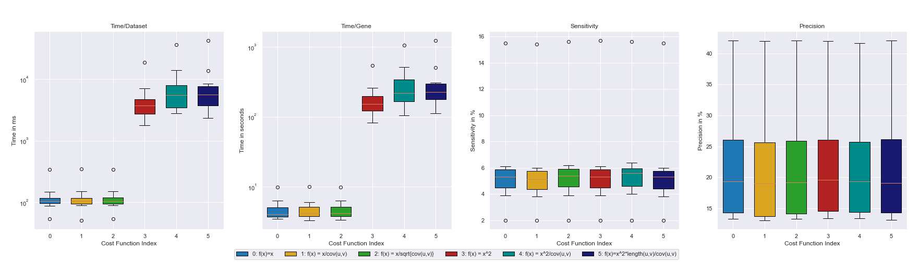
Analysis for flow-based Optimization (DPMF)

Slide 37
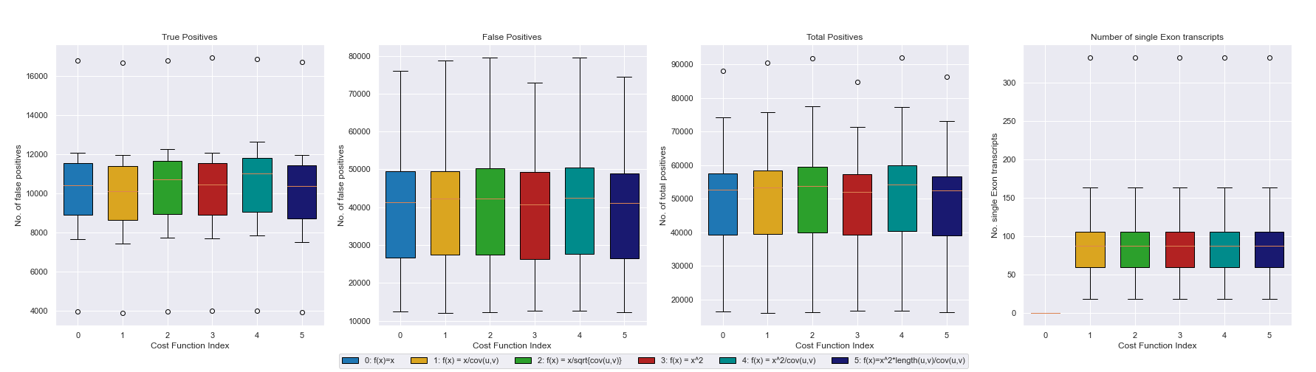
Analysis for flow-based Optimization (DPMF)

